Slide 1

Own Multiplayer Game : HousEscape
Element of Game :

Slide 2
Elements of Game
Story .
Goal .
Rules .
Feedback.
Balance .
Adaptivity .
Chance v/s Skill .
Playable and non – playable character .

Slide 3
Story for the Game
Story : Aditya and Akshay are 2 friend where they are go to an unknown house for fun. But the Ghost was waiting for people and got the people as the friend and capture them in a room

Slide 4
Goal and Rules
Goal
Rules
Both friends have to get out of the house .
Friends have 3 chances to get out of the house .
1 of the friend only can get out of the house .

Slide 5
Adaptivity
You have 5 question to answer .
How fast you join the 4 balls .
Do or Die race .
Note :-
Ghost is coming near you just
Escape the house fast !!!
Answer the Quiz
Connect the 4 balls
Win The Race

Slide 6
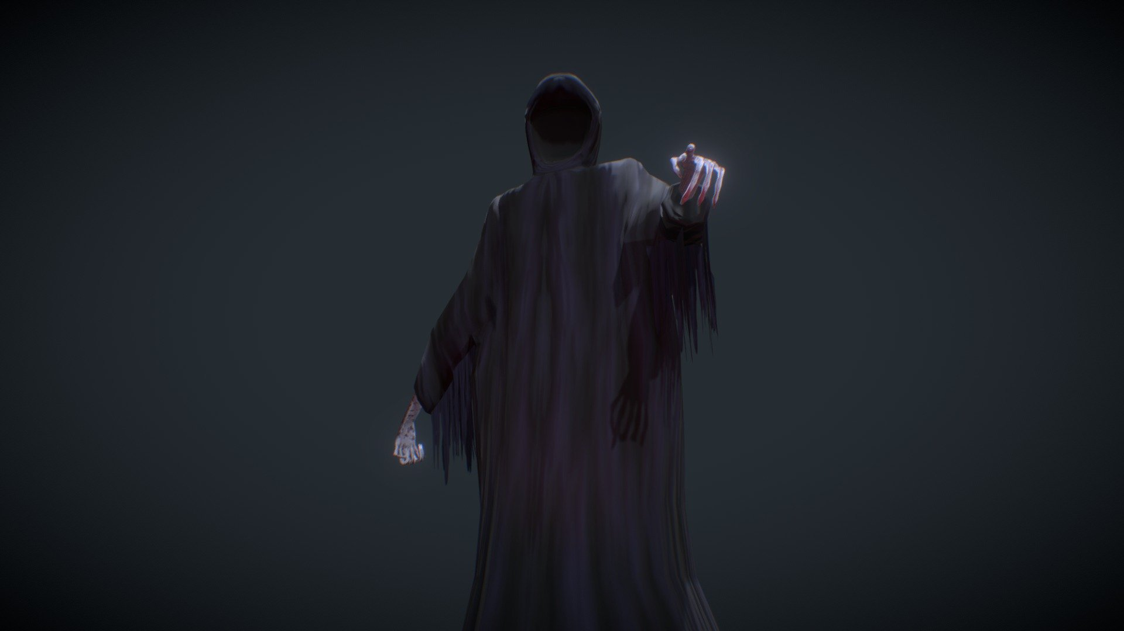
Playable character and Non-Playable character
The playable character are :
1.Aditya
2. Akshay
And Non play able character are :
1. Ghost

Slide 7

feedback
Only 1 player can come out of the house .
If a player gain 2 points he/she get out of the house .

Slide 8
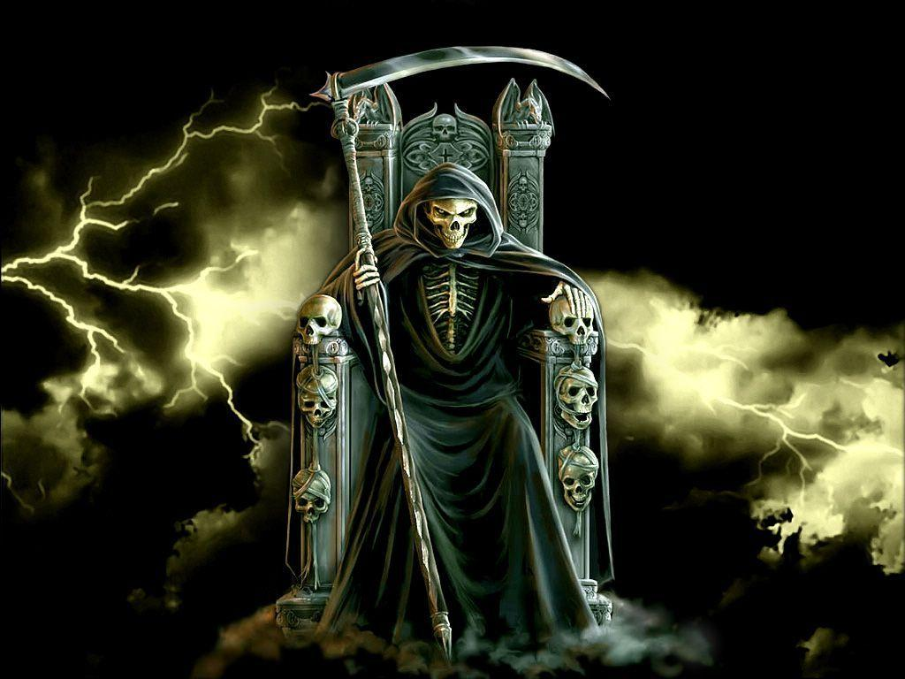
In the end of the Game
If you score low than your
Opponent you were eaten by the Ghost.

Slide 9

Made by :
Name : Aditya Kumar .

